Slide 1
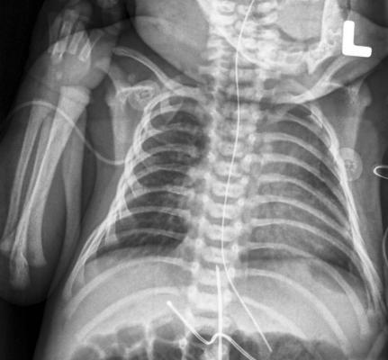
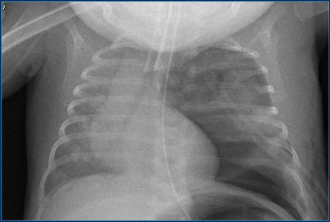
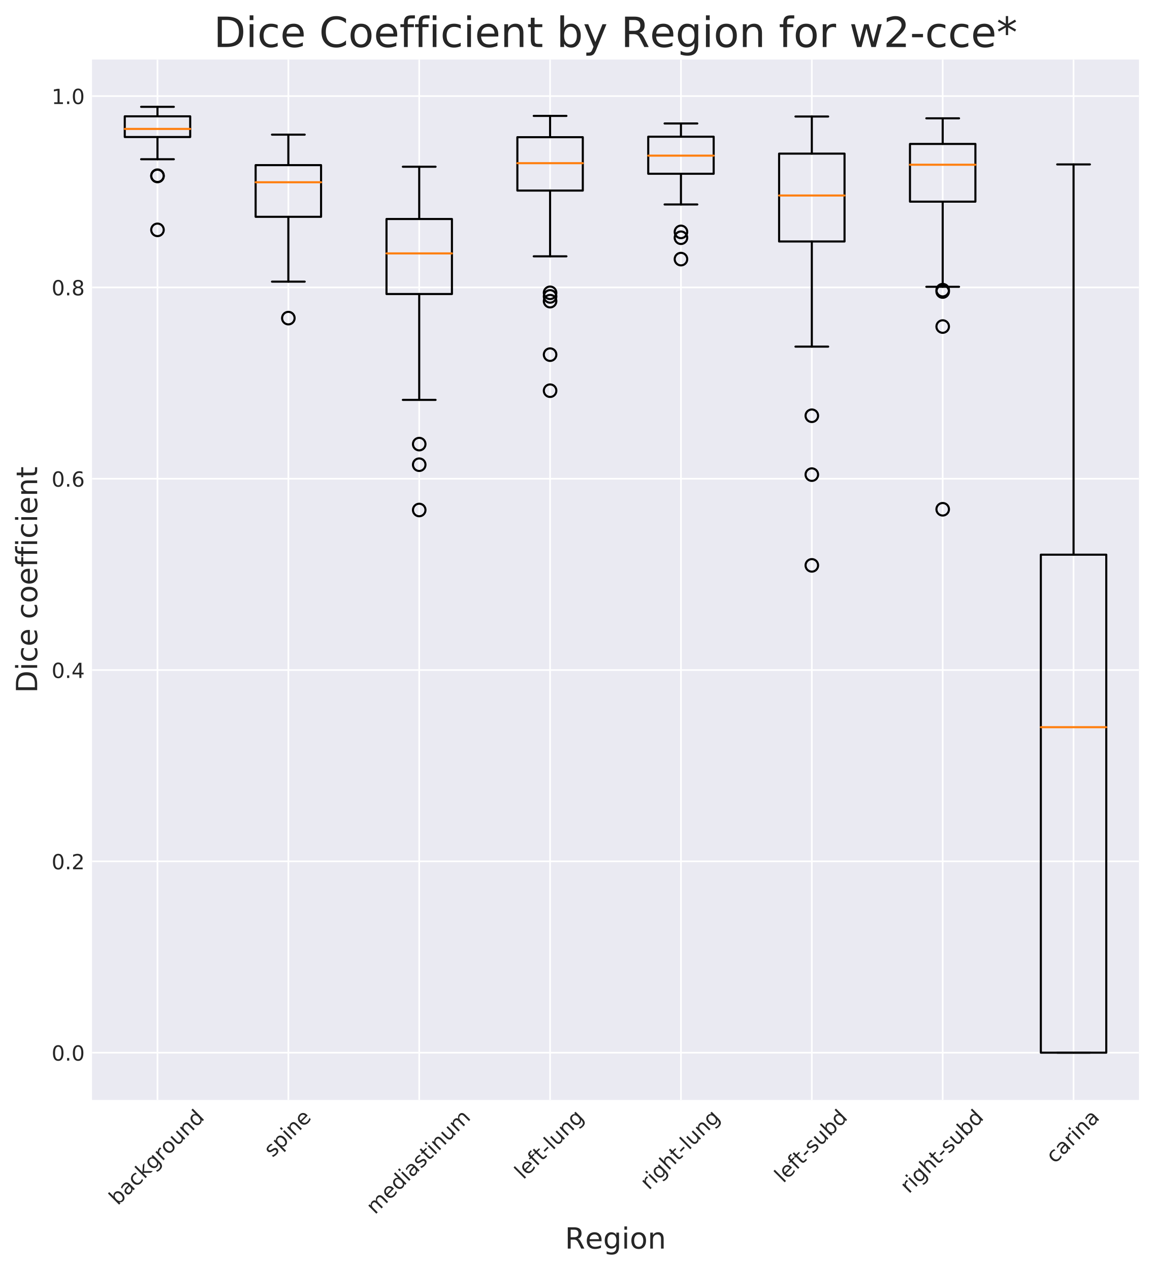
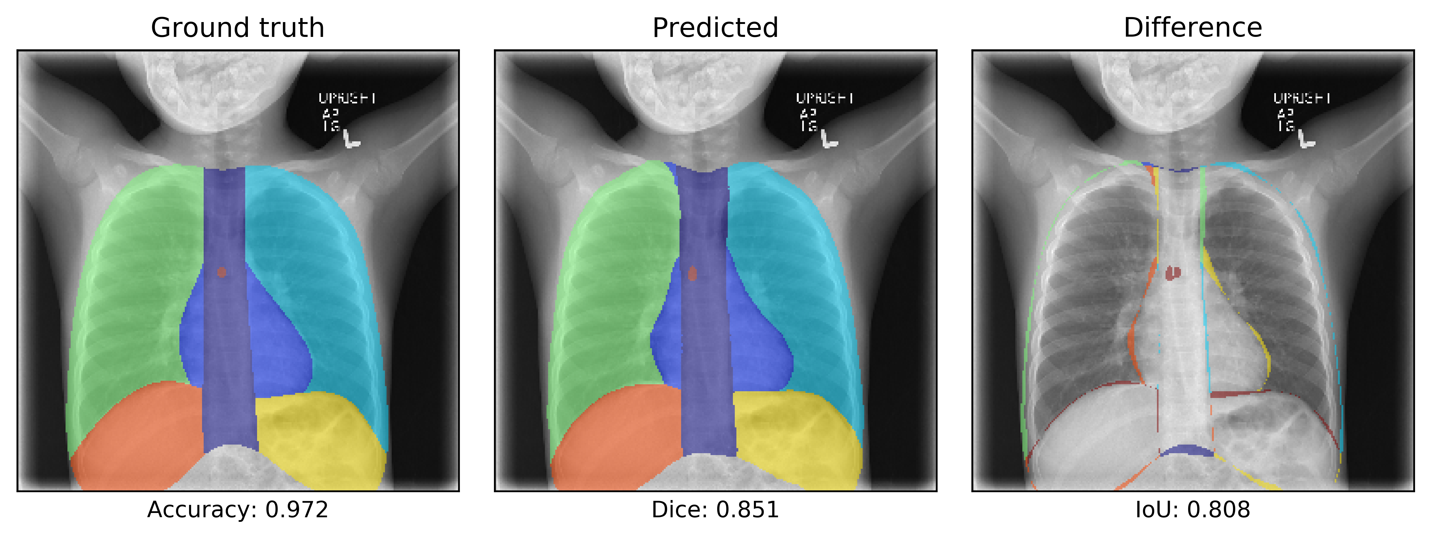
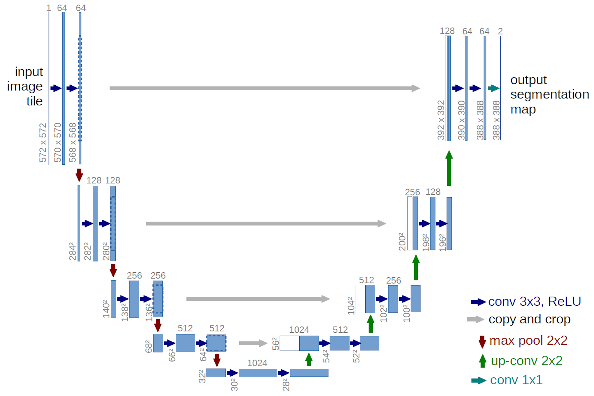
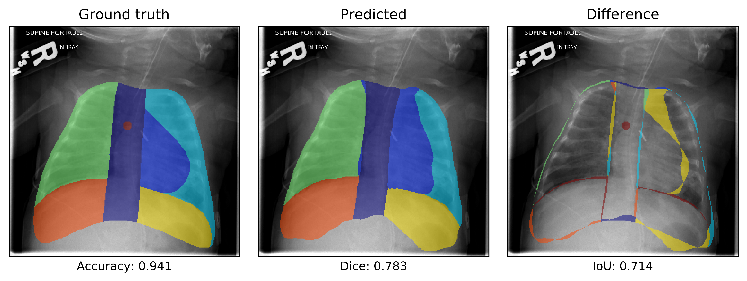
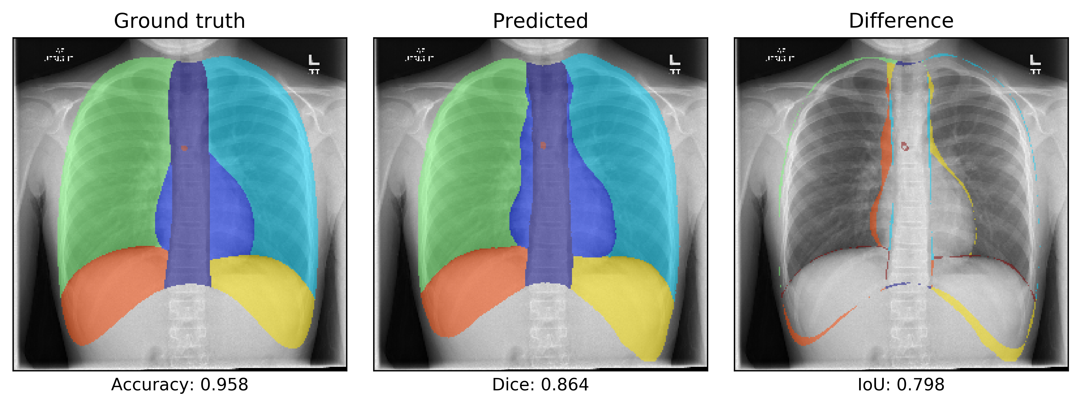




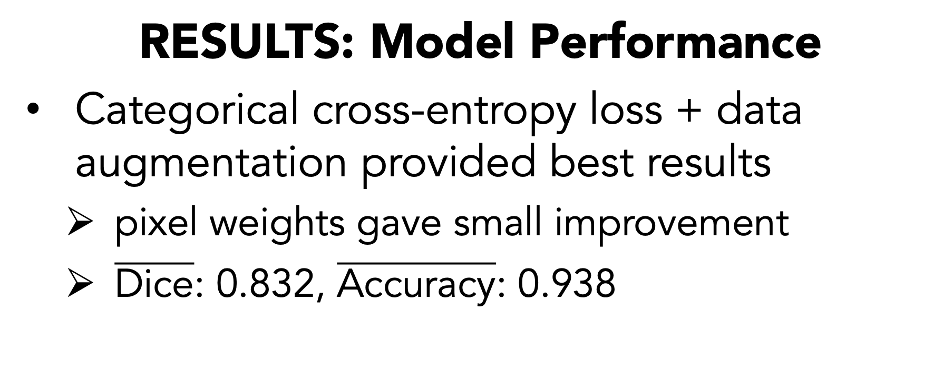
Deep neural networks can automatically find regions of the chest in pediatric radiographs.
Automatic Segmentation of Chest Radiographs with Deep Learning
Greg Holste¹, Ryan Sullivan², Nick Nagy³, Mike Bindschadler³, Adam Alessio⁴
¹Kenyon College, ²Purdue University, ³University of Washington, ⁴Michigan State University
BACKGROUND
RESULTS: Model Performance
Categorical cross-entropy loss + data augmentation provided best results
pixel weights gave small improvement
$\overline{\text{Dice}}$: 0.832, $\overline{\text{Accuracy}}$: 0.938
Figure 1. Two typical pediatric radiographs with lines marked by red arrows.
Loss Function | Dice
w2-cce* | 0.832
w3-cce* | 0.83
w1-cce* | 0.829
cce + gdl* | 0.828
cce* | 0.828
w2-cce | 0.825
cce + gdl | 0.821
w3-cce | 0.82
cce | 0.815
w1-cce | 0.814
w3-gdl | 0.788
w1-gdl | 0.787
gdl | 0.784
w2-gdl | 0.783
Critically ill patients need catheters & tubes (“lines”) to sustain life
monitoring their placement is time-consuming & labor-intensive
Goal: automate with deep learning
segment chest into regions
find & classify lines
determine if in correct location
RESULTS: Predictions
METHODS
Figure 4. Mean Dice coefficient on test set (n=70) by loss function (left) and box-and-whisker plot of Dice coefficients by class for the best model (right). “*” = with data augmentation, “cce” = categorical cross-entropy, “gdl” = generalized Dice loss, “w<no.>” = with pre-computed pixel weights from method <no.>.
8
FUTURE WORK
Train on higher-resolution images
Obtain more, higher-quality labels
or… more aggressive augmentation
Ensure predictions are biologically sound
guarantee single instance of each class
prohibit disconnected regions
Combine with line detector
Figure 2. U-Net model architecture (Ronneberger et al. 2015). Each blue box is a feature map, with height and width in the lower left and depth on top. While the feature dimensions do not exactly match those of our model, the red “8” represents that we adapted this architecture to predict eight output classes.
Trained U-Net on 300+ labeled radiographs
tested loss functions, weighting schemes, & data augmentation
REFERENCES
Ronneberger, Olaf, Philipp Fischer, and Thomas Brox. "U-net: Convolutional networks for biomedical image segmentation." International Conference on Medical image computing and computer-assisted intervention. Springer, Cham, 2015.
Crum, William R., Oscar Camara, and Derek LG Hill. "Generalized overlap measures for evaluation and validation in medical image analysis." IEEE transactions on medical imaging 25.11 (2006): 1451-1461.
Categorical cross-entropy:
Generalized Dice loss:
Figure 3. Best-performing model’s predictions for three radiographs that it has not been trained on. Pixel accuracy, Dice coefficient, and intersection over union (IoU) appear as x-axis labels on the left, middle, and right subplots respectively.
versus
ACKNOWLEDGMENTS
We acknowledge support from the iCER ACRES REU at MSU, which is funded by the National Science Foundation through grant 1560168.
n = pixel, c = class
y_{n,c} = 1 if pixel n belongs to class c, otherwise 0
p_{n,c} = probability that pixel n belongs to class c
w_{n} = pre-computed “weight” of pixel n
1 if unweighted
Take a picture to see more predictions.
Notes:
Future work: train on larger resolution images, more aggressive augmentation, more sophisticated weighting scheme, combine w/ line detector …

